Slide 1
Automated Reasoning for Security Protocols
Rob Lorch
4/23/26

Slide 2
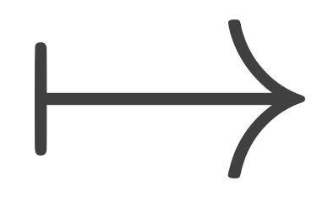
Introduction & Motivation
Most of the Internet runs on layers of security protocols
DNSSEC secures URL IP address mappings; prevents masquerading
TLS promises confidentiality, authenticity, and integrity for application layer
X.509 certificate validation secures public key identity mappings
4G LTE/5G promises confidentiality and authentication of cellular networks
Uptane promises authenticity and integrity of vehicle OTA software updates
And many more…

Slide 3
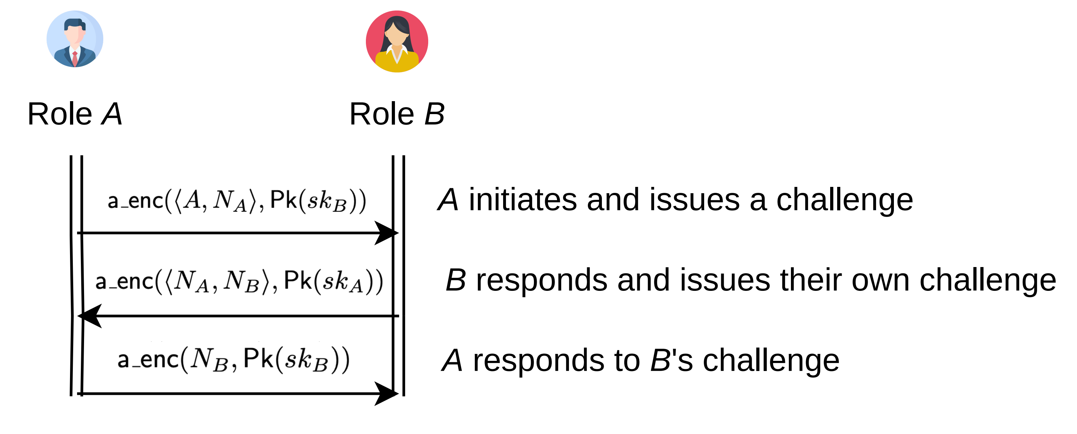
Introduction & Motivation
Security protocols are hard to get right
Canonical example is the Needham-Schroeder public key mutual authentication protocol
Vulnerability went undiscovered for 17 years

Slide 4
Introduction & Motivation
Modern protocols are orders of magnitude more complicated!
TLS, X.509 certificate validation, 4G/5G LTE, Uptane, Signal messaging, ...
SOTA security protocol verification is impressive
Needham-Schroeder (& variants) can be precisely analyzed with full automation (both attacks and proofs of security)
Modern tools can formally verify protocols like TLS and Signal
SOTA security protocol verification has room for improvement
Biggest verification attempts pioneered by tool developers with deep knowledge of internals
Approaches that do not rely on expert knowledge make other tradeoffs (abstraction/refinement techniques compose results from two separate models in different formalisms and rely on manual intervention)

Slide 5
Roadmap
Objective
Cryptographic protocol verification background
Threat models and their relationships
Formalizing security protocols
Formalizing security properties
Breaking, fixing, and breaking Needham-Schroeder
Key compromise
Type confusion!
Making reasoning expressive (prior work & open questions)
Making reasoning tractable (prior work & open questions)
Discussion & Conclusion

Slide 6
Roadmap
Objective
Cryptographic protocol verification background
Threat models and their relationships
Separate sections? Question: what is my goal, and what do I need to get there?
Security properties
Formalization (MSR? Applied pi calculus? Both? One?)
Reasoning techniques
Breaking, fixing, and breaking Needham-Schroeder
Key compromise
Type confusion!
Making reasoning expressive (prior work & open questions)
Making reasoning tractable (prior work & open questions)
Discussion & Conclusion

Slide 7
Objectives
Mechanize reasoning about cryptographic protocol security
Automate reasoning about cryptographic protocol security
Proofs of security
Attack traces to witness insecurity
Ideally, reason in an unbounded setting

Slide 8
Roadmap
Objective
Cryptographic protocol verification background
Threat models and their relationships
Formalizing security protocols
Formalizing security properties
Breaking, fixing, and breaking Needham-Schroeder
Key compromise
Type confusion!
Making reasoning expressive
Making reasoning tractable
Discussion & Conclusion

Slide 9
Mathematical Cryptography: Primitives & Protocols
Example protocol: roles, primitives

Slide 10
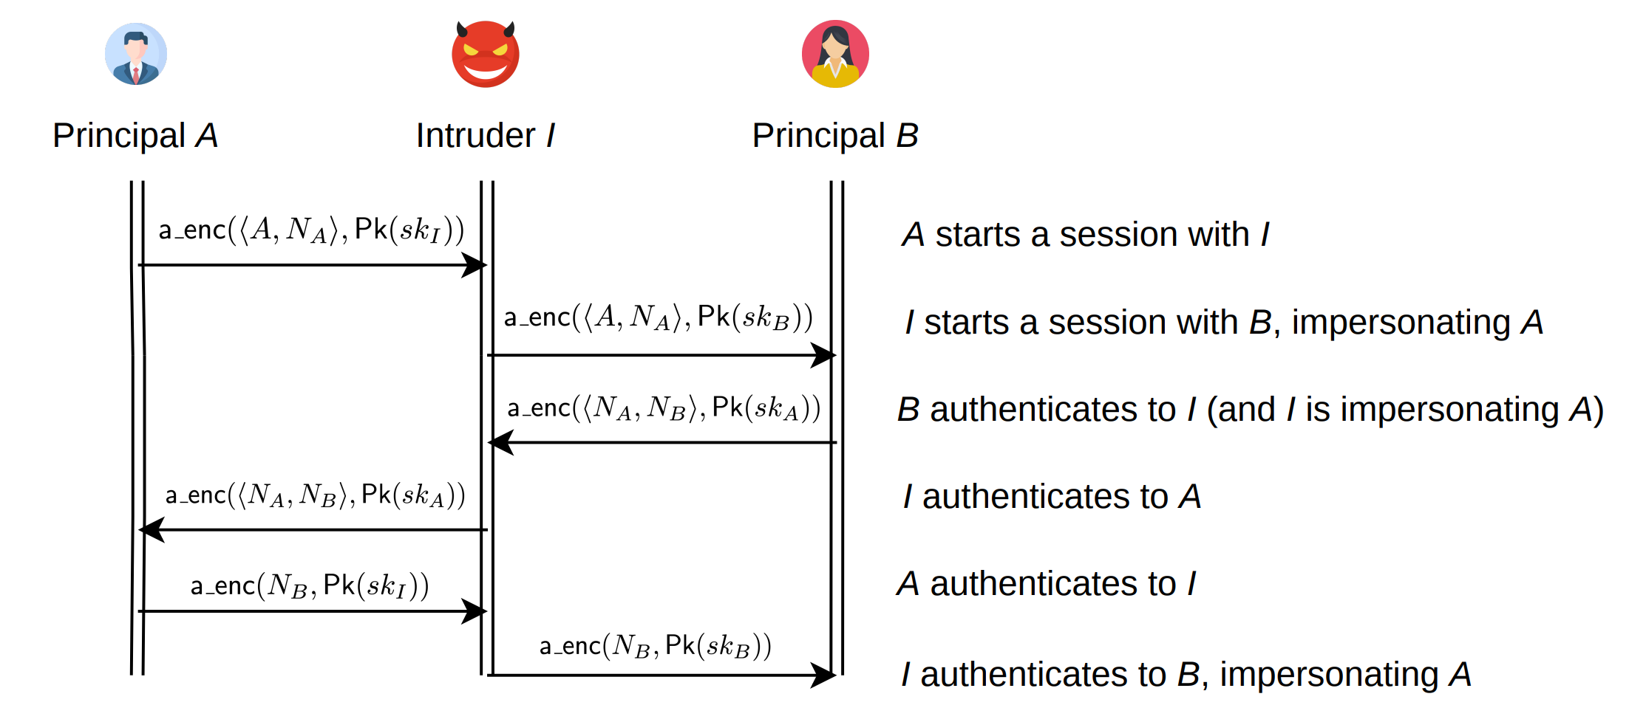
Mathematical Cryptography: Primitives & Protocols
Example protocol: adversary, trace

Slide 11
Mathematical Cryptography: Primitives & Protocols
Example protocol: adversary, trace

Slide 12
Mathematical Cryptography: Primitives & Protocols
Example protocol: adversary, trace

Slide 13
Mathematical Cryptography: Primitives & Protocols
Cryptographic protocol vs primitive

Slide 14
Mathematical Cryptography: Primitives & Protocols
Cryptographic protocol vs primitive

Slide 15
Mathematical Cryptography: Primitives & Protocols
Cryptographic protocol vs primitive

Slide 16
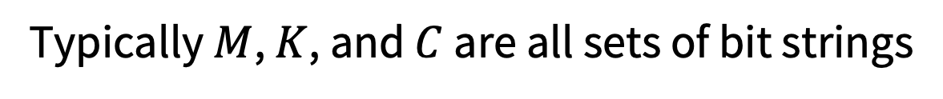
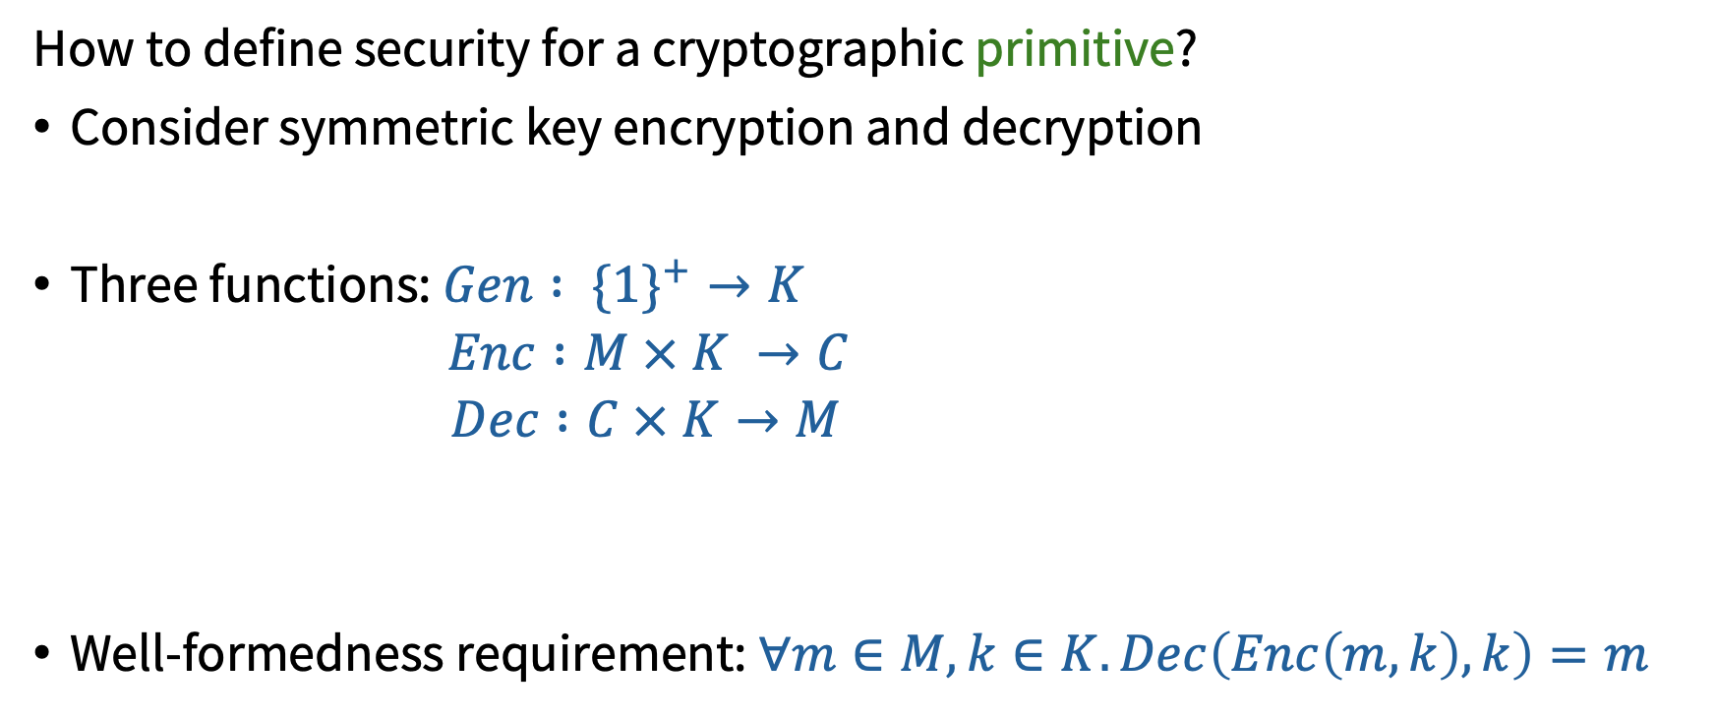
Mathematical Cryptography: Primitives & Protocols
How to define security for a cryptographic primitive?
Consider symmetric key encryption and decryption
Three functions: $Gen : \{1\}^{+}→K$
$Enc :M × K →C$
$Dec :C × K→M$
Well-formedness requirement: $∀m∈M, k∈K. Dec\left(Enc\left(m, k\right), k\right)=m$
Typically $M$, $K$, and $C$ are all sets of bit strings

Slide 17
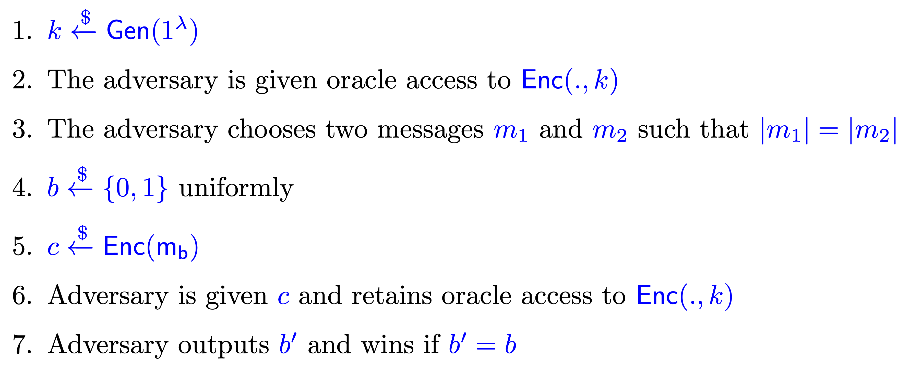

Mathematical Cryptography: Security of Primitives
We play a cryptographic game between a challenger and an adversary
Scheme is IND-CPA secure iff $\operatorname{Pr}\left[Adversary wins game\right]≤\frac{1}{2}+negl\left(λ\right)$

Slide 18
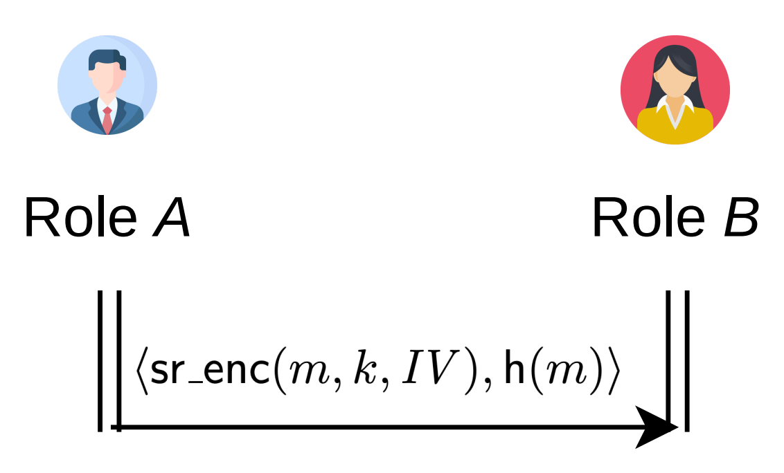
Mathematical Cryptography: Security of Protocols
How to define security for a cryptographic protocol?
Define a protocol-level game
Assume primitives are secure
Consider a simple protocol

Slide 19

Mathematical Cryptography: Security of Protocols
Assume $sr_enc(.,.,.)$is IND-CPA secure
Assume $h(.)$is a collision-resistant, one-way function
Lift IND-CPA security game to the pair $⟨sr_enc\left(m, k, IV\right), h(m)⟩$
Adversary can pick any $m_{1}$ and $m_{2}$ such that $\left|m_{1}\right|=\left|m_{2}\right|$ and $m_{1}≠m_{2}$
Adversary guesses which was chosen by computing $h(m_{1})$ and $h\left(m_{2}\right)$and comparing to the second element of the pair

Slide 20
Mathematical Cryptography: Security of Protocols
Secure primitives do not necessarily imply a secure protocol
From now on, we assume primitives are secure and focus on protocol verification
Primitives can be analyzed separately

Slide 21
How to make reasoning easier?
Remember our goal: mechanize & automate reasoning
Prior work mechanizes reasoning about cryptographic protocols with cryptographic games
Reasoning about cryptographic games (and their compositions) is currently too difficult to effectively automate

Slide 22
Threat Models
Computational adversary capabilities
Computational model
Closely follows mathematical cryptography
Adversaries are probabilistic polynomial time (PPT) Turing machines
Symbolic model (a.k.a. Dolev-Yao model)
Assumes primitives are perfectly secure
Considers non-probabilistic (often weaker) security properties
Adversary can drop and inject arbitrary messages respecting cryptographic assumptions
Useful in practice!
Exploiting weaknesses of primitives
Exploiting protocol weaknesses
Non-polynomial computation
Symbolic adversary capabilities

Slide 23
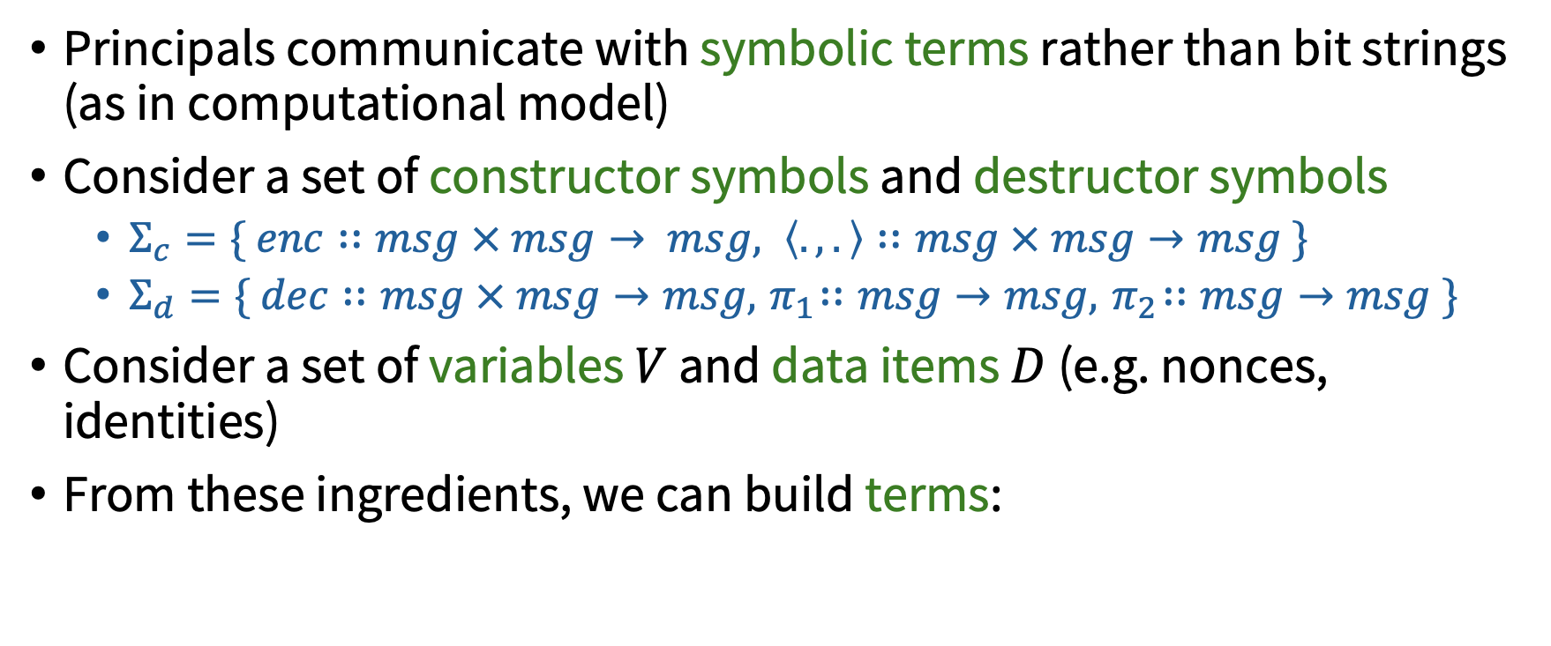
Symbolic Model
Principals communicate with symbolic terms rather than bit strings (as in computational model)
Consider a set of constructor symbols and destructor symbols
$Σ_{c}=\{ enc∷msg × msg→ msg, \left\langle .,.\right\rangle ∷msg × msg→msg \}$
$Σ_{d}=\{ dec∷msg × msg→msg, { π}_{1}∷msg→msg, { π}_{2}∷msg→msg \}$
Consider a set of variables $V$ and data items $D$ (e.g. nonces, identities)
From these ingredients, we can build terms:
$$enc\left(n_{a}, k\right), dec\left(enc\left(n_{a}, k\right),k\right), …$$

Slide 24
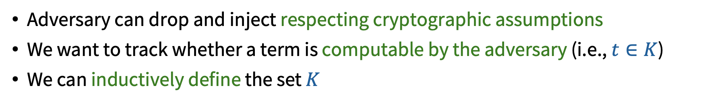
Symbolic Model
Adversary can drop and inject respecting cryptographic assumptions
We want to track whether a term is computable by the adversary (i.e., $t∈K$)
We can inductively define the set $K$
$t$ is marked public
$$t∈K$$

Slide 25
Symbolic Model
Adversary can drop and inject respecting cryptographic assumptions
We want to track whether a term is computable by the adversary (i.e., $t∈K$)
We can inductively define the set $K$
$t$ was sent on the network
$$t∈K$$

Slide 26

Symbolic Model
Adversary can drop and inject respecting cryptographic assumptions
We want to track whether a term is computable by the adversary (i.e., $t∈K$)
We can inductively define the set $K$
$t_{1}∈K$ $t_{2}∈K$
$enc(t_{1}, t_{2})∈K$ $t_{2}∈K$
$$enc(t_{1},t_{2})∈K$$
$$t_{1}∈K$$

Slide 27






Symbolic Model
Adversary can drop and inject respecting cryptographic assumptions
We want to track whether a term is computable by the adversary (i.e., $t∈K$)
We can inductively define the set $K$
$t_{1}∈K$ $t_{2}∈K$
$$⟨t_{1},t_{2}⟩∈K$$
$$⟨t_{1},t_{2}⟩∈K$$
$$⟨t_{1}, t_{2}⟩∈K$$
$$t_{1}∈K$$
$$t_{2}∈K$$

Slide 28
Formalizing Security Protocols in the Symbolic Model
How to reason about protocols? We need…
A way to formalize protocols
Asynchronous communication with symbolic terms
Nondeterministic adversarial influence
Weave together different protocol sessions
Executable specification (going from specifications to traces)
A way to formalize security properties
A means of checking if protocols satisfy properties

Slide 29
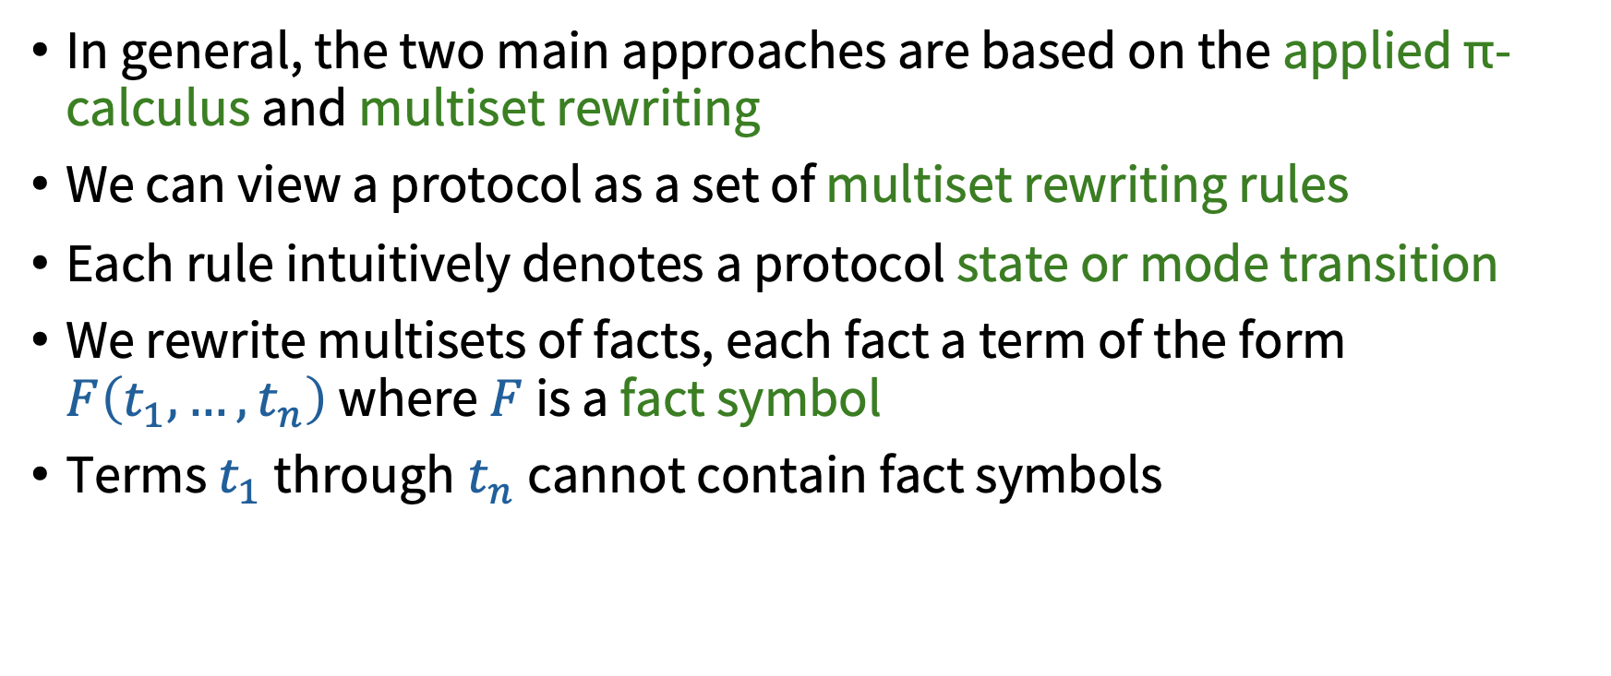
Formalizing Security Protocols in the Symbolic Model
In general, the two main approaches are based on the applied π-calculus and multiset rewriting
We can view a protocol as a set of multiset rewriting rules
Each rule intuitively denotes a protocol state or mode transition
We rewrite multisets of facts, each fact a term of the form $F\left(t_{1},…,t_{n}\right)$ where $F$ is a fact symbol
Terms $t_{1}$through$t_{n}$cannot contain fact symbols

Slide 30
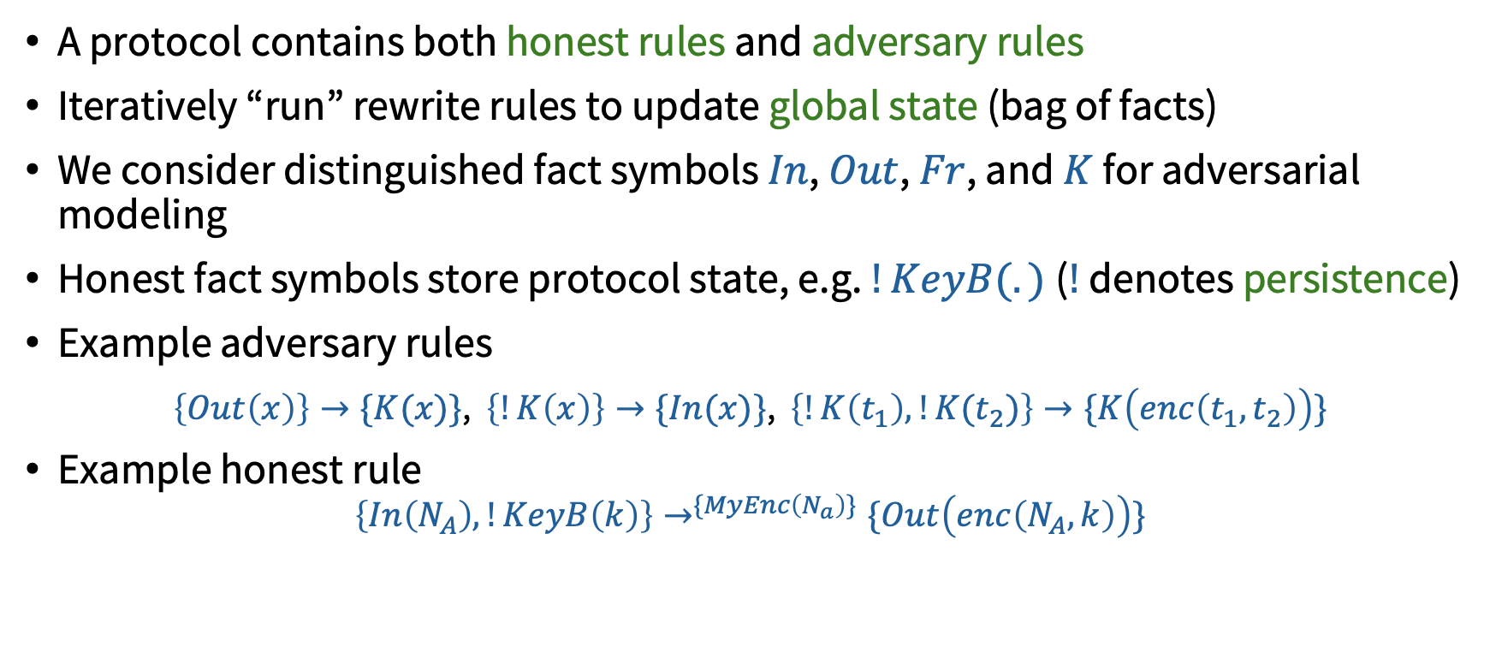
Formalizing Security Protocols in the Symbolic Model
A protocol contains both honest rules and adversary rules
Iteratively “run” rewrite rules to update global state (bag of facts)
We consider distinguished fact symbols $In$, $Out$, $Fr$, and $K$ for adversarial modeling
Honest fact symbols store protocol state, e.g. $!KeyB(.)$($!$ denotes persistence)
Example adversary rules
$\left\{Out\left(x\right)\right\}→\{K(x)\}$, $\left\{!K\left(x\right)\right\}→\{In(x)\}$, $\left\{!K\left(t_{1}\right), !K(t_{2})\right\}→\{K\left(enc\left(t_{1},t_{2}\right)\right)\}$
Example honest rule
$$\left\{In\left(N_{A}\right), !KeyB\left(k\right)\right\}→^{\{MyEnc\left(N_{a}\right)\}}\{Out\left(enc\left(N_{A}, k\right)\right)\}$$
Steps can be labeled with facts, called action facts

Slide 31
Formalizing Security Protocols in the Symbolic Model
Given a set of rewrite rules $R$, we can define a labeled transition relation $→_{R}^{α}$
$$l→^{α}r∈ginsts(R) l⊆^{\#}S$$
$$S→_{R}^{α}\left({S \backslash }^{\#} l\right)∪^{\#}r$$

Slide 32
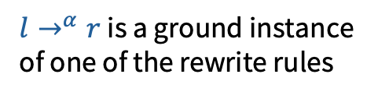
Formalizing Security Protocols in the Symbolic Model
Given a set of rewrite rules $R$, we can define a labeled transition relation $→_{R}^{α}$
$l→^{α}r$ is a ground instance of one of the rewrite rules
$$l→^{α}r∈ginsts(R) l⊆^{\#}S$$
$$S→_{R}^{α}\left({S \backslash }^{\#} l\right)∪^{\#}r$$

Slide 33

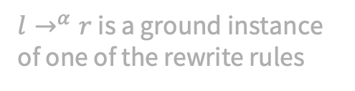
Formalizing Security Protocols in the Symbolic Model
Given a set of rewrite rules $R$, we can define a labeled transition relation $→_{R}^{α}$
$l→^{α}r$ is a ground instance of one of the rewrite rules
The current state contains $l$
$$l→^{α}r∈ginsts(R) l⊆^{\#}S$$
$$S→_{R}^{α}\left({S \backslash }^{\#} l\right)∪^{\#}r$$

Slide 34

Formalizing Security Protocols in the Symbolic Model
Given a set of rewrite rules $R$, we can define a labeled transition relation $→_{R}^{α}$
$l→^{α}r$ is a ground instance of one of the rewrite rules
The current state contains $l$
$$l→^{α}r∈ginsts(R) l⊆^{\#}S$$
$$S→_{R}^{α}\left({S \backslash }^{\#} l\right)∪^{\#}r$$
Update global state by removing l and introducing r

Slide 35
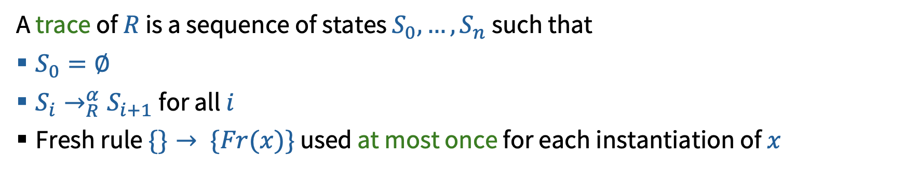
Formalizing Security Protocols in the Symbolic Model
Given a set of rewrite rules $R$, we can define a labeled transition relation $→_{R}^{α}$
$l→^{α}r$ is a ground instance of one of the rewrite rules
The current state contains $l$
$$l→^{α}r∈ginsts(R) l⊆^{\#}S$$
$$S→_{R}^{α}\left({S \backslash }^{\#} l\right)∪^{\#}r$$
Update global state by removing l and introducing r
A trace of $R$ is a sequence of states $S_{0}, …, S_{n}$such that
$S_{0}=∅$
$S_{i}→_{R}^{α}S_{i+1}$for all $i$
Fresh rule $\{\}→ \{Fr(x)\}$ used at most once for each instantiation of $x$

Slide 36
Formalizing Needham-Schroeder
First, a means of key generation
$\left\{Fr(sk)\right\}→\{Sk\left(Id, sk\right), Pk\left(Id, pk\left(sk\right)\right), Out(⟨Id, pk(sk)⟩)\}$

Slide 37
Formalizing Needham-Schroeder
First, a means of key generation
$\left\{Fr(sk)\right\}→\{Sk\left(Id, sk\right), Pk\left(Id, pk\left(sk\right)\right), Out(⟨Id, pk(sk)⟩)\}$
A rule for each honest step
$\left\{Fr\left(N_{A}\right), !Pk\left(Id,Pk_{A}\right),!Pk(Id,Pk_{B})\right\}→\{StA1\left(A, B , N_{A}\right), Out(a_enc(⟨A,N_{A}⟩,Pk_{B}))\}$

Slide 38
Formalizing Needham-Schroeder
First, a means of key generation
$\left\{Fr(sk)\right\}→\{Sk\left(Id, sk\right), Pk\left(Id, pk\left(sk\right)\right), Out(⟨Id, pk(sk)⟩)\}$
A rule for each honest step
$\left\{Fr\left(N_{A}\right), !Pk\left(Id,Pk_{A}\right),!Pk(Id,Pk_{B})\right\}→\{StA1\left(A, B , N_{A}\right), Out(a_enc(⟨A,N_{A}⟩,Pk_{B}))\}$
...

Slide 39
Formalizing Needham-Schroeder
How to generate a trace?
1. $\left\{Fr(sk)\right\}→\{Sk\left(Id, sk\right), Pk\left(Id, pk\left(sk\right)\right), Out(⟨Id, pk(sk)⟩)\}$
2. $\left\{Fr\left(N_{A}\right), !Pk\left(Id,Pk_{A}\right),!Pk(Id,Pk_{B})\right\}→\{StA1\left(A, B , N_{A}\right), Out(a_enc(⟨A,N_{A}⟩,Pk_{B}))\}$
...
$$S_{0}=∅$$
Apply $\{\}→\{Fr(sk)\}$
$$S_{1}=\{Fr(sk)\}$$
Apply rule 1
$$S_{2}=\{Sk\left(Id, sk\right), Pk\left(Id, pk\left(sk\right)\right), Out(⟨Id, pk(sk)⟩)\}$$
…

Slide 40
Formalizing Security Properties in the Symbolic Model
Security properties can be partitioned into trace properties and hyper properties
Typical security properties are safety (“something bad never happens”), not liveness (“something good eventually happens”)

Slide 41
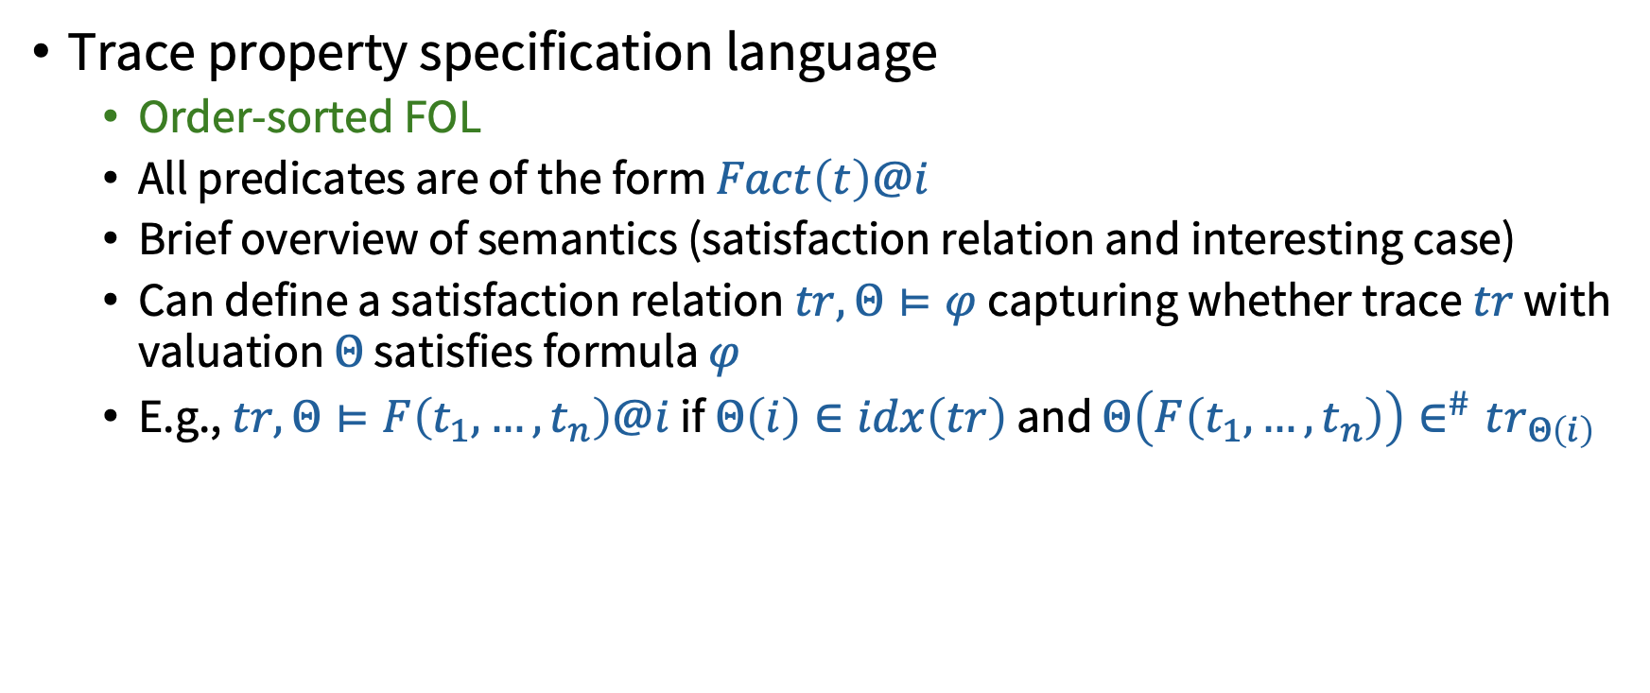
Formalizing Security Properties in the Symbolic Model
Trace property specification language
Order-sorted FOL
All predicates are of the form $Fact\left(t\right)@i$
Brief overview of semantics (satisfaction relation and interesting case)
Can define a satisfaction relation $tr, Θ⊨φ$ capturing whether trace $tr$ with valuation $Θ$ satisfies formula $φ$
E.g., $tr, Θ⊨F\left(t_{1},…,t_{n}\right)@i$ if $Θ\left(i\right)∈idx\left(tr\right)$ and $Θ\left(F\left(t_{1},…, t_{n}\right)\right)∈^{\#}tr_{Θ\left(i\right)}$

Slide 42

Formalizing Security Properties in the Symbolic Model
Weak secrecy: No secret term appears in $K$
$$∀x, i. Secret\left(x\right)@i⇒¬(∃j.K\left(x\right)@j)$$

Slide 43

Formalizing Security Properties in the Symbolic Model
Non-injective agreement: If principal $A$ received data item $d$ apparently from principal $B$, then previously principal $B$ sent data item $d$ apparently to principal $A$
$$∀A, B, t, i. Accept\left(A, B, t\right)@i⇒(∃j. Sent\left(B,A,t\right)@j \& j<i)$$

Slide 44


Formalizing Security Properties in the Symbolic Model
Injective agreement: There is an injective mapping between data items received by principal $A$ apparently from principal $B$, and data items sent from principal $B$ apparently to principal $A$
$∀A, B, t, i. Accept\left(A, B, t\right)@i⇒(∃j. Sent\left(B,A,t\right)@j \& j<i)$ &
$$¬(∃A_{2},B_{2},i_{2}.Accept\left(A_{2},B_{2},t\right)@i_{2}\& i_{2}≠i)$$
No distinct accept with the same $t$

Slide 45



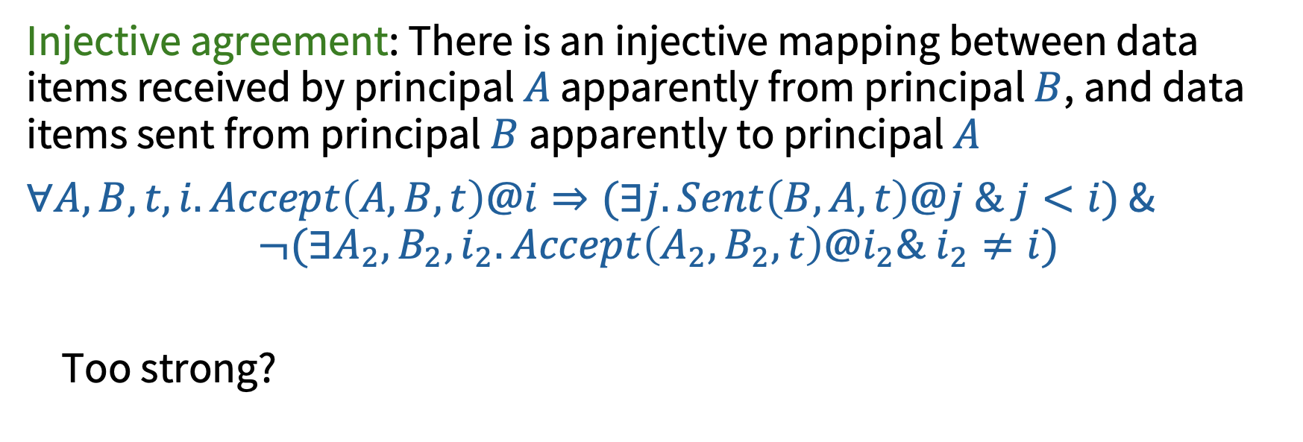



Formalizing Security Properties in the Symbolic Model
Injective agreement: There is an injective mapping between data items received by principal $A$ apparently from principal $B$, and data items sent from principal $B$ apparently to principal $A$
$∀A, B, t, i. Accept\left(A, B, t\right)@i⇒(∃j. Sent\left(B,A,t\right)@j \& j<i)$ &
$$¬(∃A_{2},B_{2},i_{2}.Accept\left(A_{2},B_{2},t\right)@i_{2}\& i_{2}≠i)$$
Too strong?
Sent by A
Accepted by B
Sent by A
Accepted by B
$$d$$
$$d$$
$$d$$
$$d$$
$$d$$
$$d$$
$$d$$
$$d$$

Slide 46

Automated Property Satisfaction/Violation
Given a rewrite system $R$ and a property $φ$, how to tell if some trace of $R$ violates $φ$?

Slide 47
Formalizing Security Properties in the Symbolic Model
Diff equivalence: Two protocols are diff equivalent if …

Slide 48
Roadmap
Objective
Cryptographic protocol verification background
Threat models and their relationships
Formalizing security protocols
Formalizing security properties
Breaking, fixing, and breaking Needham-Schroeder
Key compromise
Type confusion!
Making reasoning expressive
Making reasoning tractable
Discussion & Conclusion

Slide 49
Needham-Schroeder Public Key Protocol

Slide 50
Needham-Schroeder Public Key Protocol

Slide 51
Needham-Schroeder Public Key Protocol

Slide 52
Needham-Schroeder Public Key Protocol

Slide 53

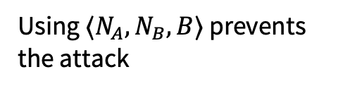
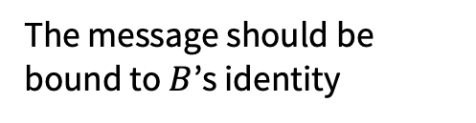
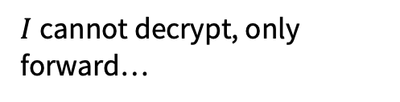



First Attack on Needham-Schroeder
$$1. A→B:a_enc(\left\langle A,N_{A}\right\rangle , Pk(sk_{B}))$$
$$2. B→A:a_enc(\left\langle N_{A},N_{B}\right\rangle , Pk(sk_{A}))$$
$$3. A→B:a_enc(N_{B}, Pk(sk_{B}))$$
Should be noticed by $A$!
$I$cannot decrypt, only forward…
The message should be bound to $B$’s identity
Using $⟨N_{A}, N_{B}, B⟩$ prevents the attack
Notes:
In the “B authenticates to I (impersonating A)” step, B is also issuing a challenge. I steals that challenge and has A do it for him. A won’t notice because he doesn’t see an identity mismatch.

Slide 54

First Attack on Needham-Schroeder
$$1. A→B:a_enc(\left\langle A,N_{A}\right\rangle , Pk(sk_{B}))$$
$$2. B→A:a_enc(\left\langle N_{A},N_{B}\right\rangle , Pk(sk_{A}))$$
$$3. A→B:a_enc(N_{B}, Pk(sk_{B}))$$
In our formalization, the attack does not actually work yet…
$\left\{Fr(sk)\right\}→\{Sk\left(Id, sk\right), Pk\left(Id, pk\left(sk\right)\right), Out(⟨Id, pk(sk)⟩)\}$
$\left\{Sk(Id, sk)\right\}→^{\{Reveal(Id)\}}\{Out(⟨Id, sk⟩)\}$
Key compromise of $A$ or $B$ not required!
Notes:
In the “B authenticates to I (impersonating A)” step, B is also issuing a challenge. I steals that challenge and has A do it for him. A won’t notice because he doesn’t see an identity mismatch.

Slide 55


Needham-Schroeder Public Key Protocol
Using a triple $⟨N_{A}, N_{B}, B⟩$ prevents the attack.
What about $⟨N_{A}, {⟨N}_{B},B⟩⟩$? Insecure!

Slide 56
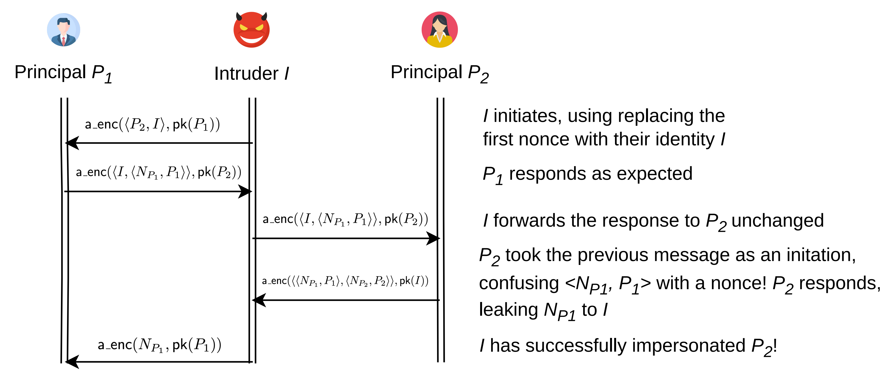

Type Confusion Attack on Needham-Schroeder
$$1. A→B:a_enc(\left\langle A,N_{A}\right\rangle , Pk(sk_{B}))$$
$$2. B→A:a_enc(\left\langle N_{A},⟨N_{B}, B⟩ \right\rangle , Pk(sk_{A}))$$
$$3. A→B:a_enc(N_{B}, Pk(sk_{B}))$$
Response is confused as an initiation!
Notes:
In the “B authenticates to I (impersonating A)” step, B is also issuing a challenge. I steals that challenge and has A do it for him. A won’t notice because he doesn’t see an identity mismatch.

Slide 57
Type Confusion Attack on Needham-Schroeder
$$1. A→B:a_enc(\left\langle A,N_{A}\right\rangle , Pk(sk_{B}))$$
$$2. B→A:a_enc(\left\langle N_{A},⟨N_{B}, B⟩ \right\rangle , Pk(sk_{A}))$$
$$3. A→B:a_enc(N_{B}, Pk(sk_{B}))$$
First and second message are unifiable (not so with the triple)
With more typing information, they do not unify with a well-typed unifier
Is this a design-level bug or a parsing bug?
Maybe give a Tamarin encoding that rules out the type confusion aspect with an explicit sort annotation on N_A
Notes:
In the “B authenticates to I (impersonating A)” step, B is also issuing a challenge. I steals that challenge and has A do it for him. A won’t notice because he doesn’t see an identity mismatch.

Slide 58
Roadmap
Cryptographic protocol verification background
Threat models and their relationships
Formalizing security protocols
Formalizing security properties
Breaking, fixing, and breaking Needham-Schroeder
Key compromise
Type confusion!
Making reasoning expressive (prior work & open questions)
Making reasoning tractable (prior work & open questions)
Discussion & Conclusion

Slide 59
Roadmap
Objective
Cryptographic protocol verification background
Threat models and their relationships
Security properties
Formalization
Breaking, fixing, and breaking Needham-Schroeder
Key compromise
Type confusion!
Making reasoning expressive
Making reasoning tractable
Discussion & Conclusion

Slide 60
Making Reasoning Expressive
Equational theories
Either spi calculus to pi calculus, or Mitchell to Tamarin
Cryptographic primitives
In MSR world, go from using an encryption rule and a decryption rule to using an equational theory, and borrow techniques from term rewriting because we need congruence
Why not term rewriting for everything? You can! But at a high level, MSR naturally encodes state and TR naturally encodes algebraic properties; here we can get both
How to get XOR to work? Either compile it away [ProVerif], or partition the equational theory one part that is convergent and another part with decidable (& efficient) unification
Arithmetic
Open Q: Efficient theory reasoning for cryptographic verification?

Slide 61
Roadmap
Cryptographic protocol verification background
Threat models and their relationships
Formalizing security protocols
Formalizing security properties
Breaking, fixing, and breaking Needham-Schroeder
Key compromise
Type confusion!
Making reasoning expressive (prior work & open questions)
Making reasoning tractable (prior work & open questions)
Discussion & Conclusion

Slide 62
Roadmap
Objective
Cryptographic protocol verification background
Threat models and their relationships
Security properties
Formalization
Breaking, fixing, and breaking Needham-Schroeder
Key compromise
Type confusion!
Making reasoning expressive
Making reasoning tractable
Discussion & Conclusion

Slide 63
Making Reasoning Tractable
Strong typing assumption
It is not sound. When can it be sound? Does this help? (Kind of, but doesn't give decidability)
Typing protocols for free
How to regain decidability? Bound *both* data items and term depth
Reasoning compositionally?
Tamarin and ProVerif and inherently un-compositional…
Compositional techniques are in the tradition of security by typing

Slide 64
Roadmap
Cryptographic protocol verification background
Threat models and their relationships
Formalizing security protocols
Formalizing security properties
Breaking, fixing, and breaking Needham-Schroeder
Key compromise
Type confusion!
Making reasoning expressive (prior work & open questions)
Making reasoning tractable (prior work & open questions)
Discussion & Conclusion

Slide 65
Roadmap
Objective
Cryptographic protocol verification background
Threat models and their relationships
Formalizing security protocols
Formalizing security properties
Breaking, fixing, and breaking Needham-Schroeder
Key compromise
Type confusion!
Making reasoning expressive
Making reasoning tractable
Discussion & Conclusion

Slide 66
Discussion
Why compositional reasoning (within a single protocol) might be feasible in practice
Why theory reasoning might be feasible in practice
Why recovering interactivity might be feasible

Slide 67
Conclusion
Stuff

Slide 68
Thanks! Questions?

Slide 69
Appendix: Tamarin Property Specification Language
Language syntax and semantics

Slide 70
Appendix: CCSA Model
Computionally complete symbolic attacker (CCSA)
Fundamental tradeoffs
You can reason with full precision but lose automation (computational)
You can make simplifying assumptions but lose proof soundness (symbolic)
You can maintain automation and proof soundness but lose attack soundness (CCSA) (proof soundness arguably more important; but sometimes a lower bar is better)
BC logic, subterm reasoning/eval predicate and axiomation, cryptographic axioms, and so on

Slide 71
Appendix: BAN Logic
Acronym
Missed Needham-Schroeder bug (analysis in paper that introduced the logic!)
Relies on manual annotations of assumptions at each protocol step
Shifts adversarial reasoning largely from the logic to the user

Slide 72
Things to discuss
Could also talk about BAN and why it didn't work very well
Requires manual annotations
Doesn't reason about adversarial actions – originally sold as a benefit, but it essentially shifts adversarial reasoning from the logic to the user, which is error-prone
Public key Needham-Schroeder is BAN-secure! (check this, looks like analysis in the original paper)
Already in report
Type confusion attacks
Relationships between semantics
Give more details
Strong typing assumption, XOR vs pairing/projection
Reveal scenarios (required for Needham-Schroeder attack); give updated security properties
Example(s) where secrecy labels are over conservative
Symbolic model not strictly weaker than computational model
Not in report
Protocols involving arithmetic; how Tamarin models arithmetic
Some tidbits about CCSA – overview of the BC logic, why automated reasoning about it is hard, cryptographic axioms, and spurious counterexamples

